Slide 1
Pent-Five
1. Quintet (n.): a group of five musicians; a composition for five voices or instruments
Many rock and pop bands are a quintet of five musicians consisting of two guitarists, a bassist, a drummer, and a lead vocalist.
Create an example picture or complex sentence.

Slide 2
Pent-Five
2. pentathlon (n.): athletic contest in which each contestant competes in five different events
In a modern pentathlon, each woman competes in five track and field events, which are usually the 200-meter and 1,500-meter runs, the long jump, as well as the javelin and discus throws.
Create an example picture or complex sentence.

Slide 3
Pent-Five
3. pentagon (n.): five-sided figure
A plane geometric figure bounded by five line segments and containing five angles is a pentagon.
Create an example picture or complex sentence.

Slide 4
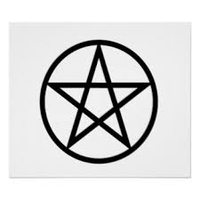
Pent-Five
4. pentagram (n.): five-pointed star drawn with five straight strokes
Pentagrams, or five-pointed stars, were used as important religious symbols by the Babylonians and by the Pythagoreans in ancient Greece.
Create an example picture or complex sentence.

