Slide 1
Bi-two
biathlon (n.) an Olympic event with two parts: a ski race and rifle marksmanship
An athlete has to have great endurance to complete both portions of a biathlon: the cross-country ski race and the target shooting to show rifle marksmanship.
Create an example picture or complex sentence.

Slide 2
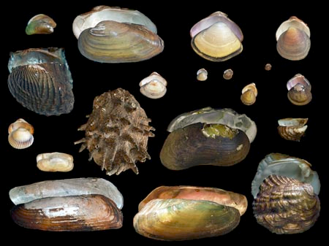
Bi-two
2. bivalve (n.) a mollusk having a two-part shell
Unlike the snail or whelk which each have only one shell , clams are bivalves.
Create an example picture or complex sentence.

Slide 3
Bi-two
binary (adj.) a set of two things; a pair
The binary number system, which involves only the numbers 0 and 1, is used in computer programming to indicate on or off.
Create an example picture or complex sentence.

Slide 4
Bi-two
4. bipartisan (adj.) supported by both political parties
The Speaker of the House and President of the Senate were able to pass a law with bipartisan agreement because it appealed to both Republicans and Democrats.
Create an example picture or complex sentence.

