Slide 1
Uni-one
unilingual (adj.) using only one language
In some foreign language classes, the teacher chooses to be unilingual so that the students hear only the language that is being taught.
Create an example picture or complex sentence.

Slide 2
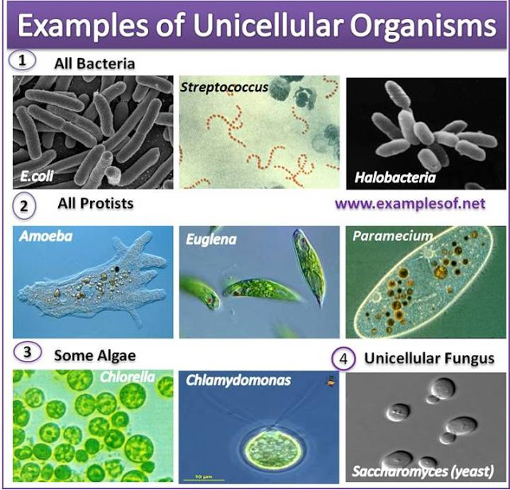
Uni-one
2. unicellular (adj.) having one cell only
Because the amoeba and paramecium are unicellular, we had to use the microscope to see these one-celled animals.
Create an example picture or complex sentence.

Slide 3
Uni-one
unit (n.) a single thing; a basis for measurement
Unit Three in our math book is the study of units of measurement, like millimeters and centimeters.
Create an example picture or complex sentence.

Slide 4
Uni-one
4. unilateral (adj.) one-sided
When the dictator made a unilateral decision to abolish the lawmaking body of the government, he did not consider the input of his advisors.
Create an example picture or complex sentence.

