Slide 1
WOW
Words of the Week
Name
Teacher

Slide 2
Mono-one
1. monotone (adj.) continuing in the same tone or pitch
Because she was nervous, Briana delivered her speech in a monotone voice as she relaxed, her speaking became much more lively and interesting.
Create an example picture or complex sentence.

Slide 3
Mono-one
2. monoplane (n.) an airplane with one wing
Unlike the Wright brothers’ plane, which had two wings, most airplanes today are monoplanes.
Create an example picture or complex sentence.

Slide 4
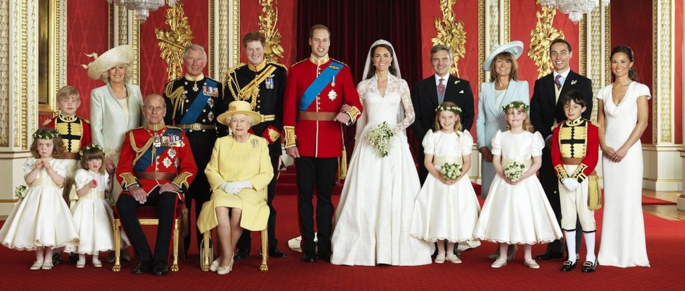
Mono-one
3. monarchy (n.) the government run by a king, queen, emperor or similar ruler
Great Britain’s form of government is a constitutional monarchy; the citizens follow their constitution and are also loyal to the Queen.
Create an example picture or complex sentence.

Slide 5
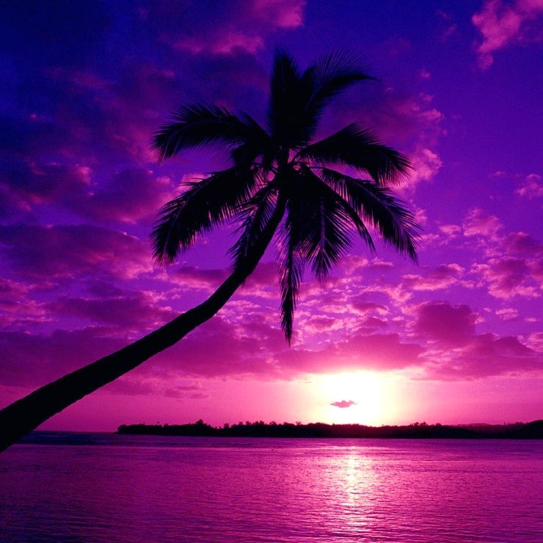
Mono-one
4. monochromatic (adj.) consisting of one color
The interior designer used a monochromatic scheme, incorporating only different shades of green to decorate the room.
Create an example picture or complex sentence.

